Slide 1
Hub/Spoke or Star system
HUB
END
END
END
Notes:
With the hub/spoke or Star system, all linking goes thru a central repeater. If the system is on full time, all repeaters hear/repeat each conversation.

Slide 2
Hub/Spoke or Star system
Pros
Simple, economical system for a general area.
Short key up time.
End sites utilize simple transceivers rather than full duplex radios with duplexers.
Link repeater can also be used as a normal repeater.
Conserves frequencies for links (only 1 pair used).
Cons
Cannot be easily expanded beyond one hop.
Notes:
The economy to this system is the fact that duplexers are not required for the link radios at each of the end sites. At the end sites, the link radios are simply a mobile transceiver and sometimes a simple mobile antenna on the roof of the shelter. If the link radio is a multi channel it could possibly be switched to a different link network for emergencies or public service.
To expand the network to a multi hop full duplex system, another full duplex radio could be added to the main controller at the hub site. This radio would not repeat it’s own audio, but only pass audio on and off the trunk. It would have a long drop out timer to prevent excessive delays up the trunk. But all repeaters on the trunk would be full duplex back to back.

Slide 3
SIMPLE END SITE
DROP REPEATER
Duplexer
TX
RX
Controller
Link Com
RLC-1
LINK RADIO
TX/RX
Half Duplex
Notes:
This is an example of a simple end site consisting of a full duplex drop repeater usually on VHF, but not always. The link radio is half duplex and does not require a duplexer if it has it’s own antenna. The controller can be a simple 2 port controller such as the Link-Comm RLC-1.

Slide 4
HUB SITE
Hub Repeater
Drop Repeater
UHF Duplexer
VHF Duplexer
TX
RX
TX
RX
SPARE
SPARE
Port 1
Port 2
Port 3
Port 4
CONTROLLER – LINK COMM RLC-4
Notes:
This is the hub site, which has the full duplex Hub repeater on UHF. It also has a VHF drop repeater. In this case the Hub UHF repeater is a normal repeater that repeats it’s audio from Rx to Tx. FARS actually has a half duplex radio on port 3 that could link into the SARA system. Port 4 could be another full duplex link to the north but it will not repeat it’s audio so as to expand the link system past the hub/spoke limitation.

Slide 5
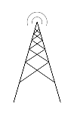
EXAMPLE CALL THROUGH THE LINK SYSTEM
VE6HRB
Down link 449.150
Full duplex
Uplink 445.150
Half duplex
VA6CTV
VE6HRA
Uplink 145.29-600=144.69c
Uplink 145.29-600=144.69
Downlink 147.000
1
2
Notes:
This is an example of a simple transparent call through the system. No codes or any special tones are required when the links are connected full time. Car 1 calls on the local repeater VHF frequency, which automatically sends the audio signal on UHF to the link hub repeater which retransmits it to all the other repeaters, which receive on UHF and send it out on the local VHF frequency of the repeaters. In this case 6HRA transmits on 147.000, and car 2 hears car 1.

Slide 6
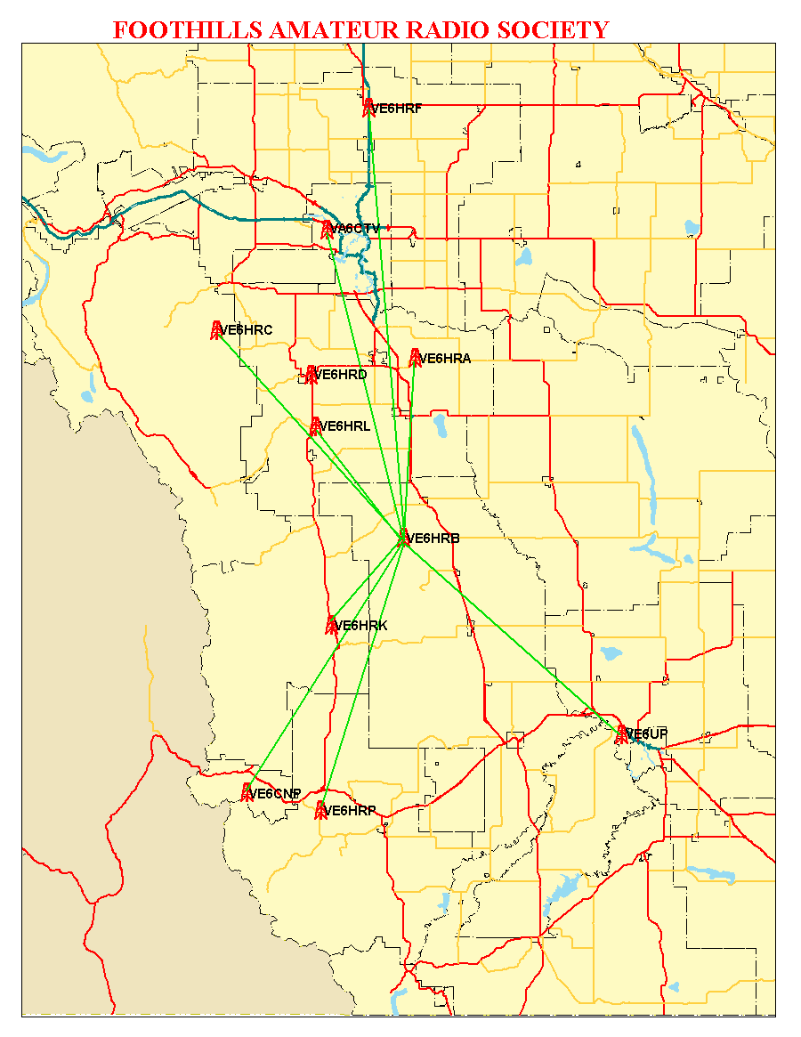
Notes:
This is a map showing the locations of the various repeaters on the FARS network, from Burmis in the south to Crossfield in the north, over 200km.

Slide 7
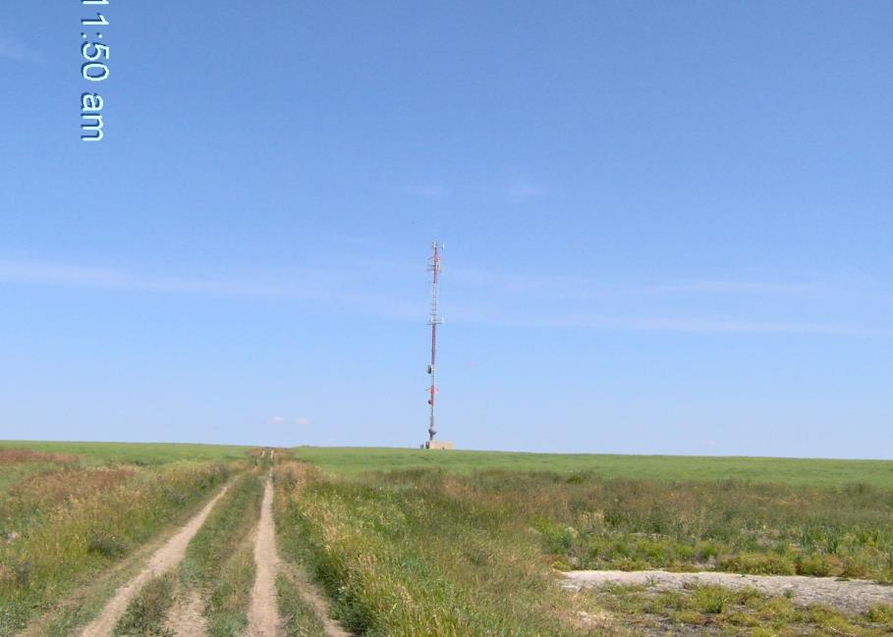
VE6HRA Gladys Ridge

Slide 8
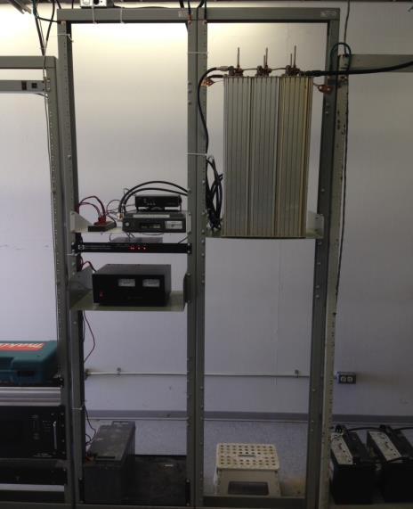
VE6HRA Gladys Ridge
Sinclair Q2330 Duplexer
Maxtrac Link
Mitrek Repeater
RLC1
Astron 35 amp Power supply
Battery back up

Slide 9
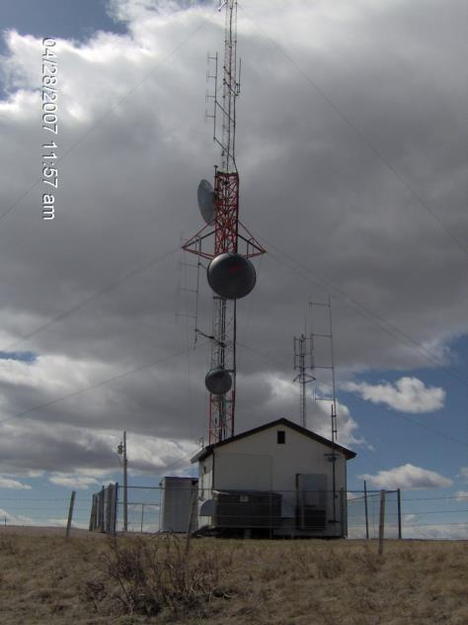
VE6HRB Nanton

Slide 10
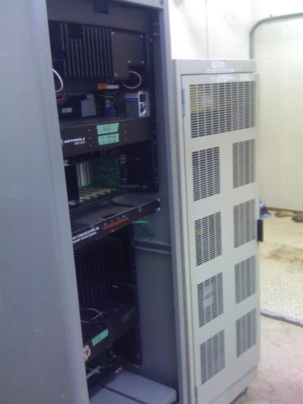
VE6HRB Nanton
Motorola MSR2000 35 watt UHF
LinkComm RLC4 Controller
Motorola MSR2000 100 watt VHF

Slide 11
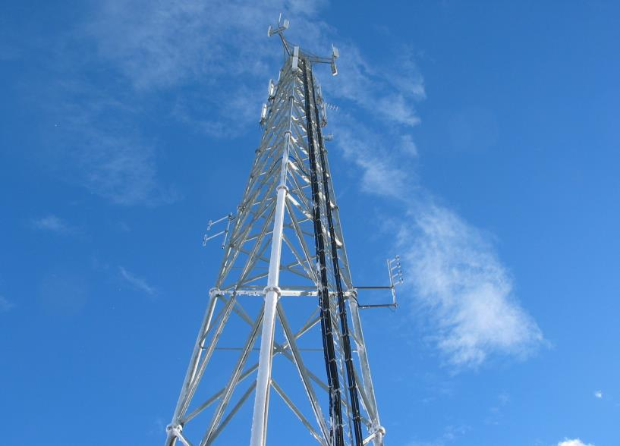
VE6HRL Longview

Slide 12
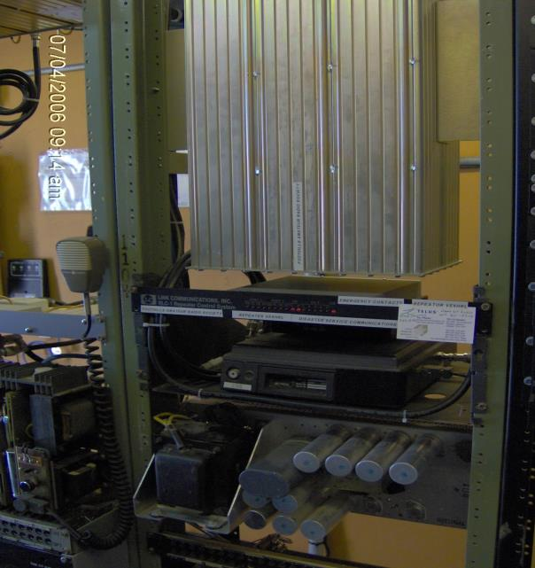
VE6HRL Longview
Sinclair Duplexer
Q2330E
LinkComm – RLC1
Motorola Maxtrac - Link
Motorola Mitrek - Rptr
Power Supply

Slide 13
Maintenance Considerations
Design Considerations
Start with a new Duplexer or one that is known to be like new condition.
Use a 6 can Res-Loc or with similar isolation specs for 600KHz VHF.
4 can Res-Loc are adequate for 5MHz UHF offsets.
Try to use commercial grade radios with helical resonator front ends.
Mobile type radios will most likely require a fan to cool the transmitter.
Run at half or less rated power (too low may cause spurious Tx).
Use CTCSS tones to prevent interference.
Check VSWR:
between repeater and duplexer regularly, record/chart.
between duplexer and antenna regularly, record/chart.
Record voltages and currents of each device.
Test run on batteries to determine condition and run time.
Record TX power and RX sensitivity, deviation.
Check audio deviation pass through between all ports

Slide 14
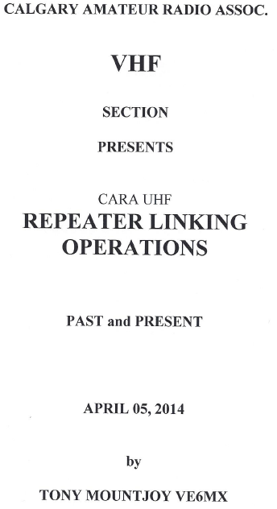

Slide 15
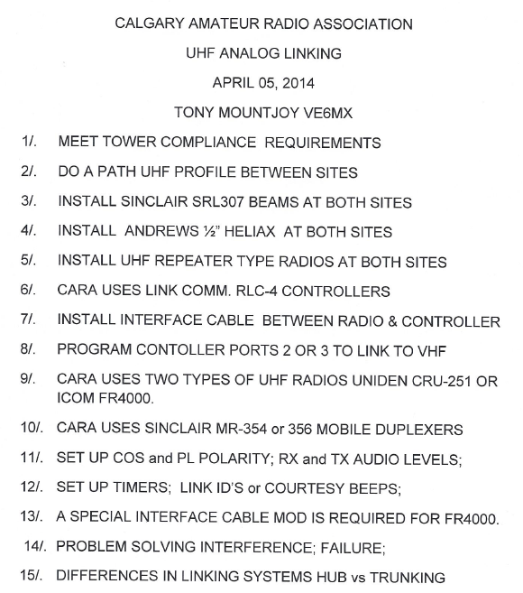

Slide 16
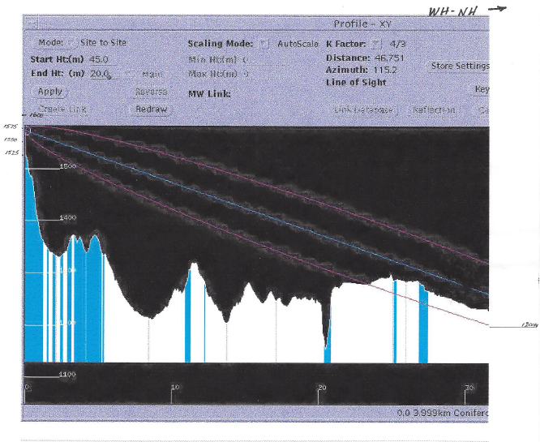

Slide 17
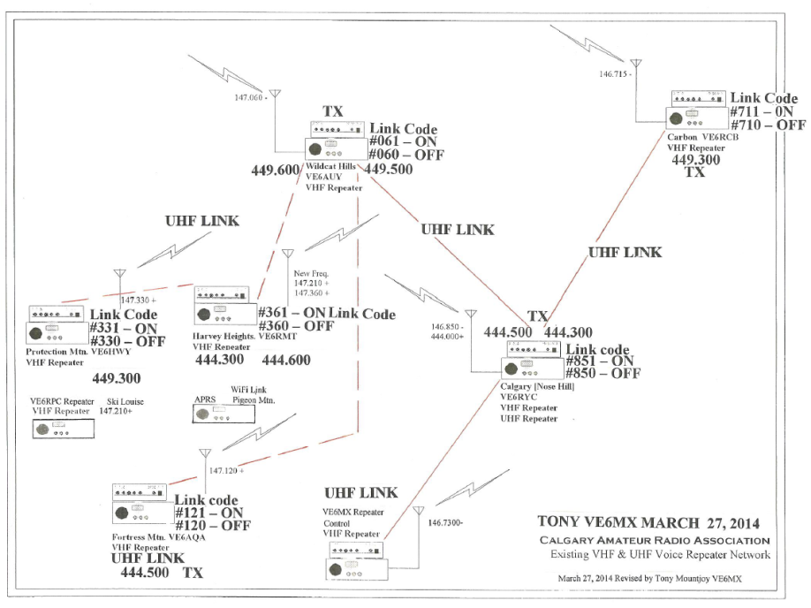

Slide 18
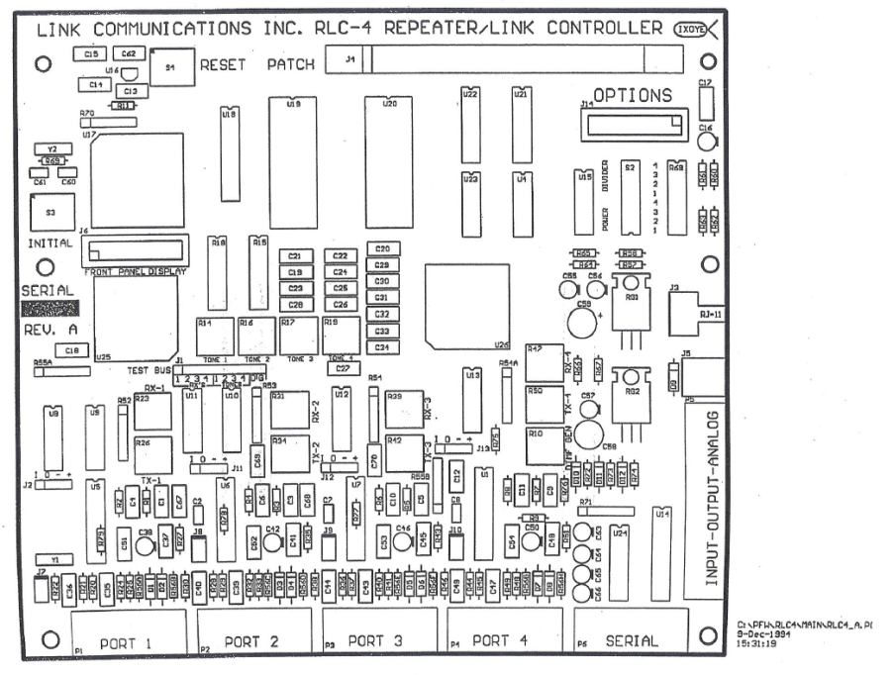

Slide 19
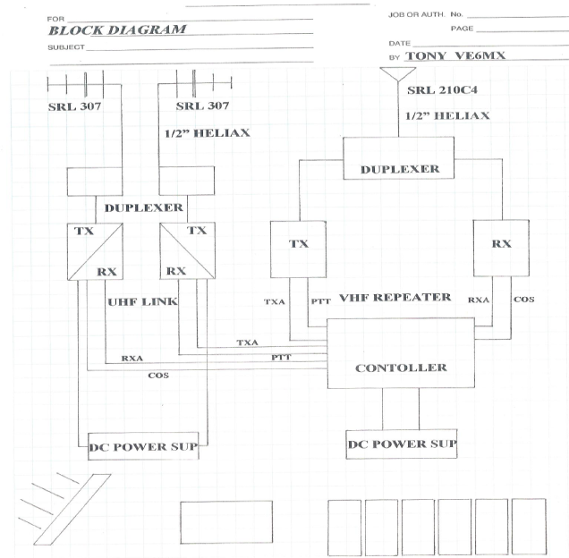

Slide 20
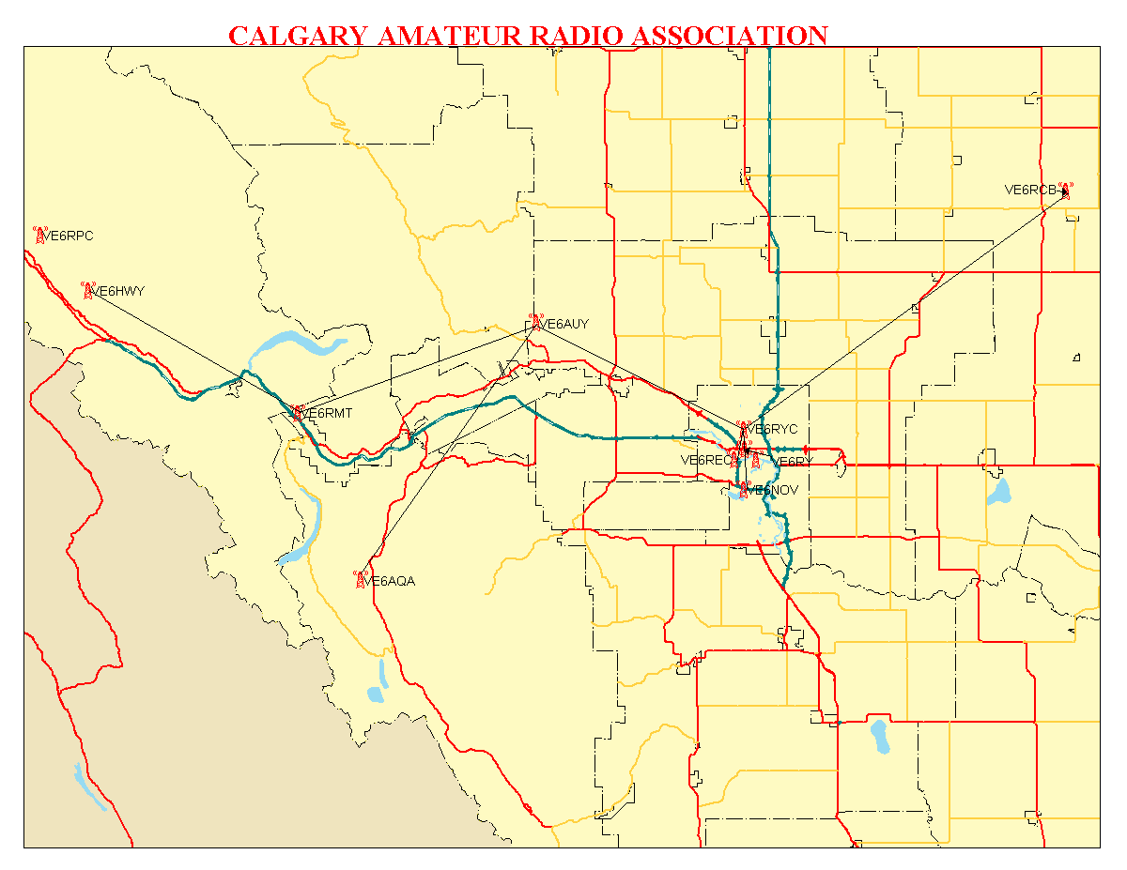

Slide 21
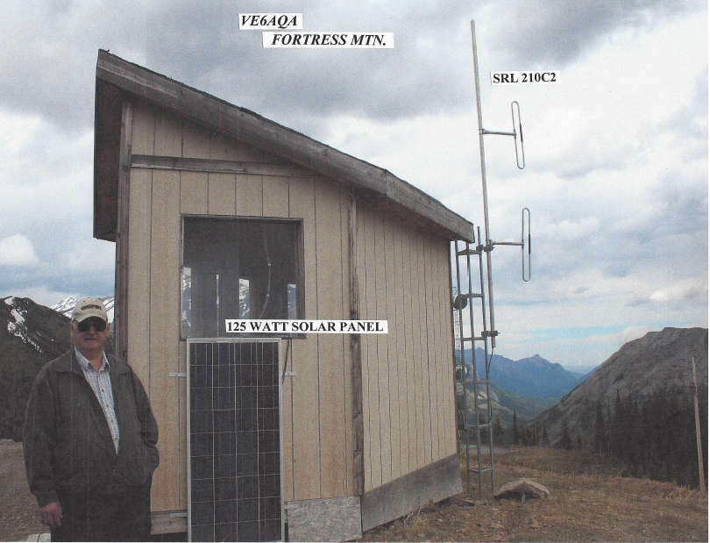

Slide 22
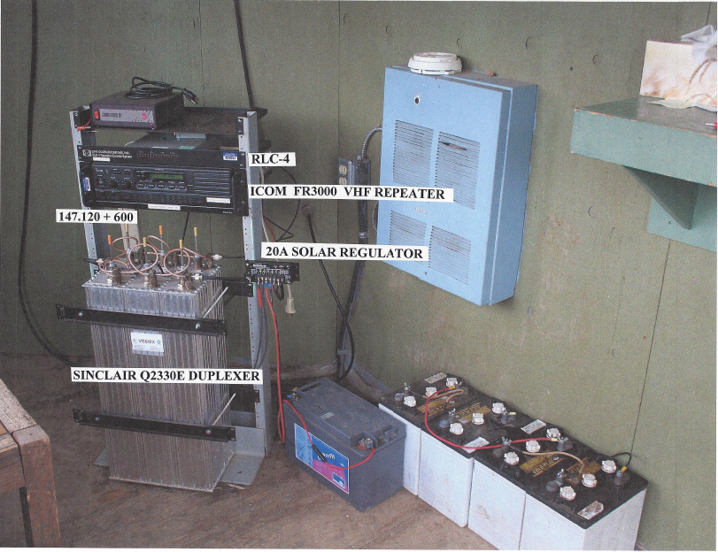

Slide 23
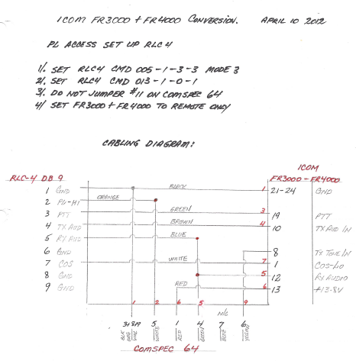

Slide 24
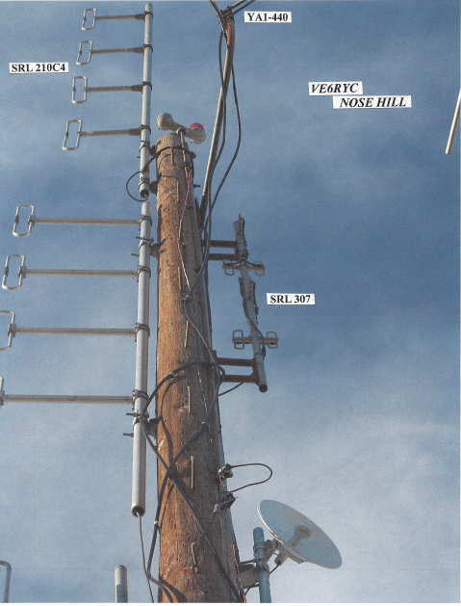

Slide 25
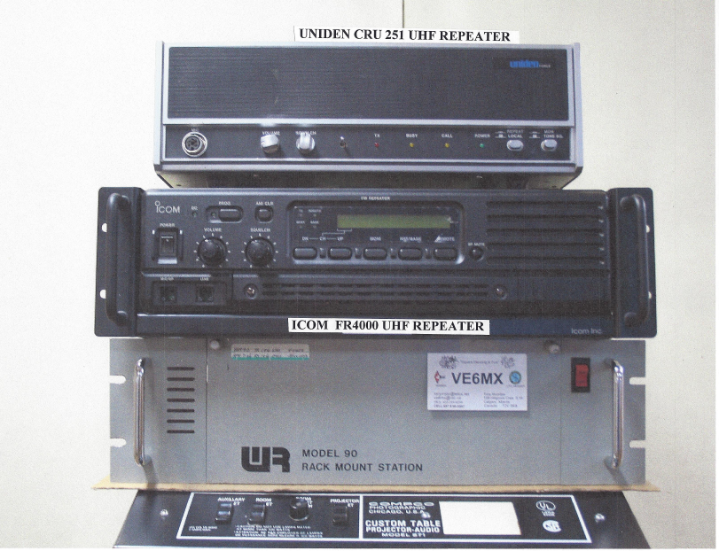

Slide 26
