Slide 1
The SARA System
Ray Semenoff VE6RHS
ve6rhs@telus.net

Slide 2
History of SARA network
1991-1994 – SARA begins a province-wide network connecting Calgary, Red Deer, & Edmonton
2000 – With Y2K funding, link radios are upgraded to Motorola GM300 series
2000-2001 – IPARN is replaced with IRLP (node 1260)
2001-2009 – SARA system slowly grows & shrinks
2014 – Complete re-design of the SARA system is in process

Slide 3
What does SARA do?
SARA provides a province-wide 70cm half-duplex “Backbone” or “Trunk” system
Amateur Radio groups wishing to connect to the SARA network provide a link radio & controller
SARA provides the Amateur Radio group with a ON & OFF link code
Connected groups are asked to eliminate hang time, courtesy tones, and identifiers from the link radio – except for connect & disconnect announcements
Connected groups are asked to provide voice only announcements

Slide 4
Development of the Backbone
Calgary (VE6OIL), Red Deer (VE6REP), and Edmonton (VE6NHB) sites are established with 2m “drop repeaters”
70cm “Hub Repeaters” are installed in Vulcan (VE6AAP), Red Deer (VE6REP), & Edmonton (VE6NHB)
VE6OIL, VE6REP, and VE6NHB are connected together using “pass-through” sites at Pigeon Lake & Balzac (now Carstairs)

Slide 5
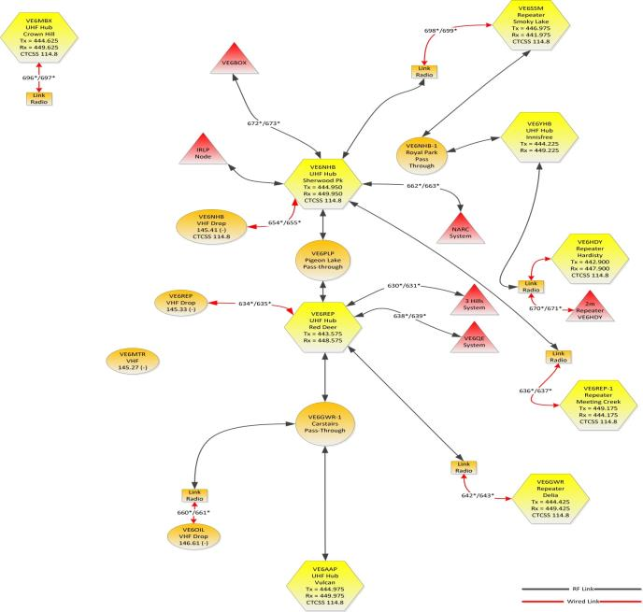
System Diagram

Slide 6
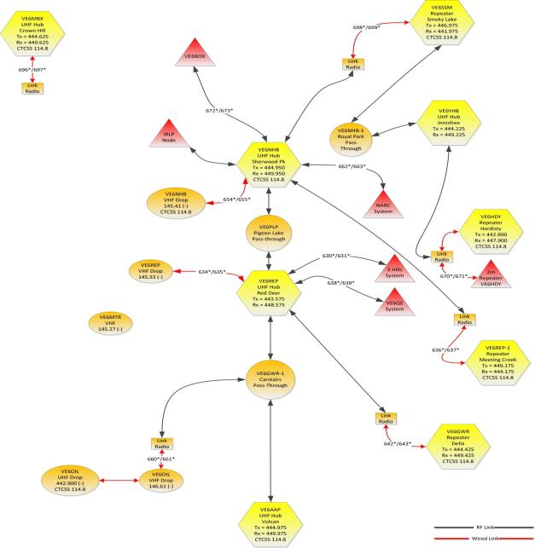
System Diagram

Slide 7
Hardware

Slide 8
Hub Repeaters
Motorola MSR-2000 and/or GM-300/Maxtrac
SCOM 7330 3-port Repeater Controllers
Battery back up DC power
Samlex or Astron DC Power supplies/chargers

Slide 9
Pass Through Sites
2 x Motorola GM-300 and/or Maxtrac
2-port Repeater Controllers or DTMF controller
Battery back up DC power
Samlex or Astron DC Power supplies/chargers

Slide 10
Repeater/Link Radios
Motorola GM-300 and/or Maxtrac
Maxtrac models require VCO alignment to perform reliably in 70cm band
All link radios are modified to remove squelch hysteresis
Depending on model, radio may have “hook switch” modified to provide full CTCSS operation
All radios use 13.8 V_{DC} power
All radios are run at 50% rated transmitter output power with forced air cooling

Slide 11
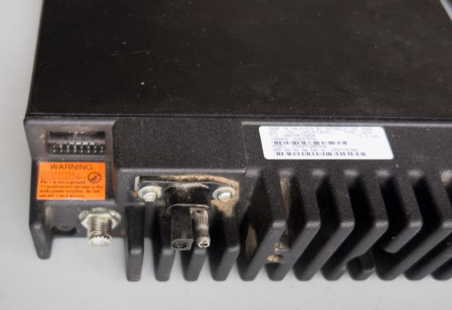
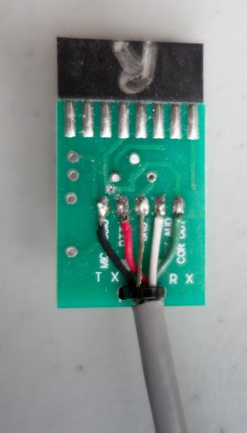
Repeater/Link Radios

Slide 12
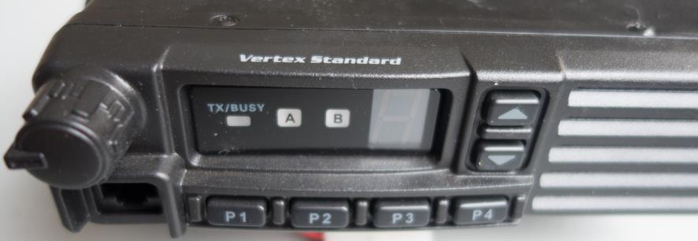
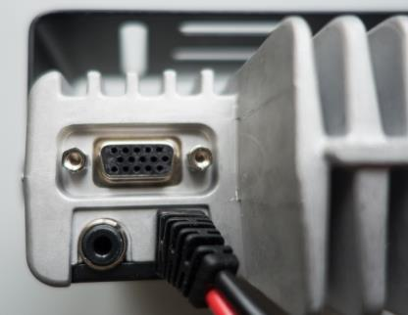
Repeater/Link Radios

Slide 13
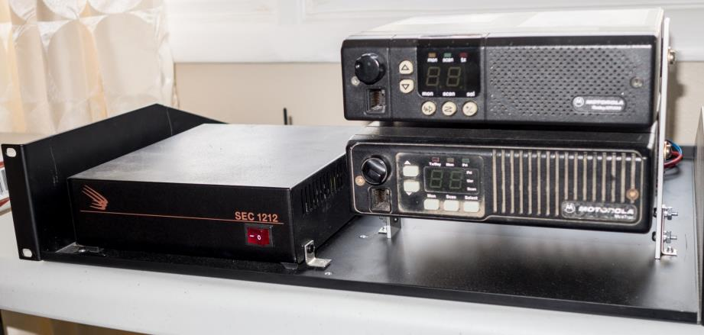
Repeater/Pass Through Hardware

Slide 14
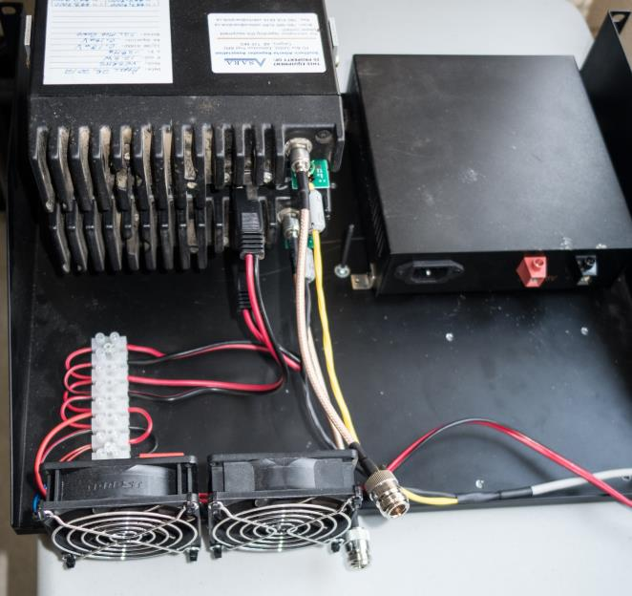
Repeater/Pass Through Hardware

Slide 15
Problems & Solutions

Slide 16
Problem: Kick-Back
Hub Repeater A
Hub Repeater B
Pass Through
How do we stop this???
The only cure for kick-back is to introduce delay at some point in the chain.

Slide 17
Kick-Back
Hub Repeater A transmits, the pass-through radios detect the Hub Repeater carrier and begin transmitting to Hub Repeater B.
Hub A drops transmit, and the pass-through radios stop transmitting VERY quickly.
Hub B is still transmitting as it’s slower to “turn around” than the pass-through radios.
Before Hub B drops carrier, the pass-through radios detect the carrier from Hub B and begin transmitting to Hub A.
This starts a “Hub-to-Hub” oscillation or “kick-back”.
The only solution to this is to add delay at either Hub A, Hub B, or the pass-through radios.
About 150ms (0.15 seconds) of delay is necessary to eliminate kick-back between Hub repeaters.

Slide 18
Problem: Delay
Transmit-to-Receive & Receive-to-Transmit switching times vary from radio to radio
CTCSS encode & decode times vary from radio to radio
Repeater/Link Controller internal switching times vary from unit to unit
20ms – 30ms delay is typical for one radio
After going through 9 radios (Calgary to Edmonton), total delay is about 0.25 seconds
Adding in “kick-back” delay of about 0.3s, total one-way delay time is just over 0.5 Seconds
Because of this, operators MUST hold their PTT down for about 0.5 seconds before speaking!

Slide 19
Problem: Audio Levels
Transmit-to-Receive & Receive-to-Transmit audio levels vary from radio to radio, and controller-to-controller
Setting correct repeater & link radio audio levels is CRITICAL
Incorrect audio levels are “multiplied” by poorly aligned repeaters & links resulting in poor audio quality throughout the network
Audio levels are properly set using a (calibrated) signal generator, FM modulation analyzer, and oscilloscope

Slide 20
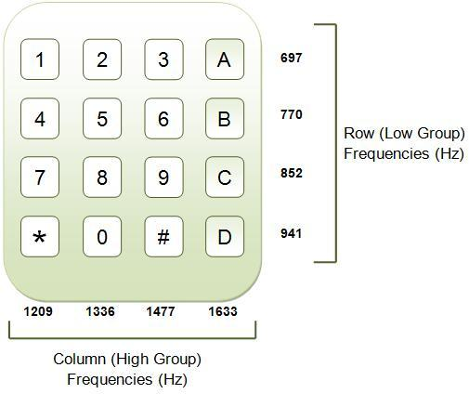
Problem: DTMF Twist
Highest frequency span = A 697Hz – 1633Hz 936Hz

Slide 21
Problem: DTMF Twist
DTMF tones must travel the length of the network and be decoded at all points.
If the system audio response is not “flat”, DTMF tones will be received at significantly different levels. If the high frequencies are emphasised, the high frequency DTMF tone may be as much as 8dB louder than the low tone.
Modern DTMF decoders will work with up to +/- 6 dB of twist. If incoming audio tones are twisted by more than 6dB, DTMF decoding will NOT take place.
Repeater controllers expect to see de-emphasised audio input, so all SARA link radios & repeaters use de-emphasised (filtered) audio, and all CTCSS tones are regenerated at every point in the system.

Slide 22
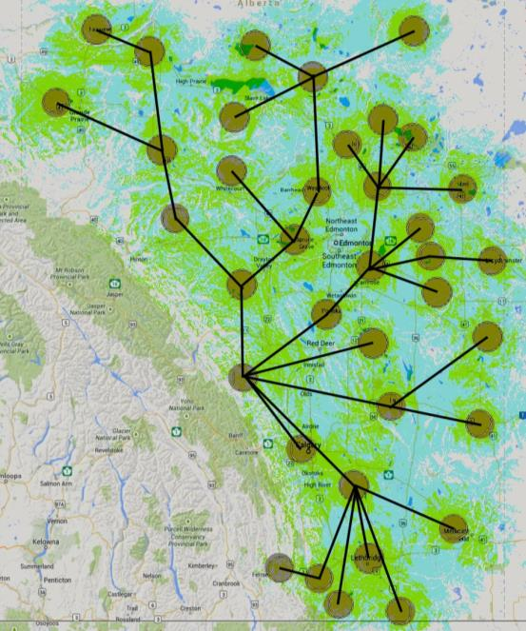
Future Plans

Slide 23
Conclusion
The SARA system is in the process of change - the SARA Web site will have the latest news on the system at all times: http://www.saralink.ca
SARA welcomes queries from Amateur Radio groups wishing to join the system.
The ultimate goal is to have the SARA system cover the majority of populated centres in Alberta.
SARA encourages ALL Amateur Radio operators to make use of the system for use while travelling, checking into province-wide nets, and/or disaster (emergency) communications.

Slide 24
Question Period
Questions???
Handouts:
SARA System Diagram
SARA System Chart
Thank You!
Ray Semenoff VE6RHS – ve6rhs@telus.net

