Slide 1
5 GHz Digital Linking
Enhanced linking with voice, data and internet
VA6DBA 2014-04-05

Slide 2
Why 5GHz?
2.4GHz will propagate further (for the same power) but….
2.4GHz is a lot more congested (only 3 non overlapping channels)
5Ghz has more channels (23 non overlapping)
5GHz supports higher power and has transmit power control
(on some channels) only uses as much as is needed.

Slide 3
Implementing the link
Do you have line of sight?
Great Web app by UBNT using google maps.
http://www.ubnt.com/airlink
Helps you to select which hardware you need to make a successful link.
Is very accurate on signal predictions see this prediction for CARA VE6AO (Club Station) to VE6RYC (Nose Hill) link.
Real Signal is -59dBm and noise floor is -92dBm latency is 1mS
Design around at least 2x speed you need and 2x Distance (Weather!)

Slide 4
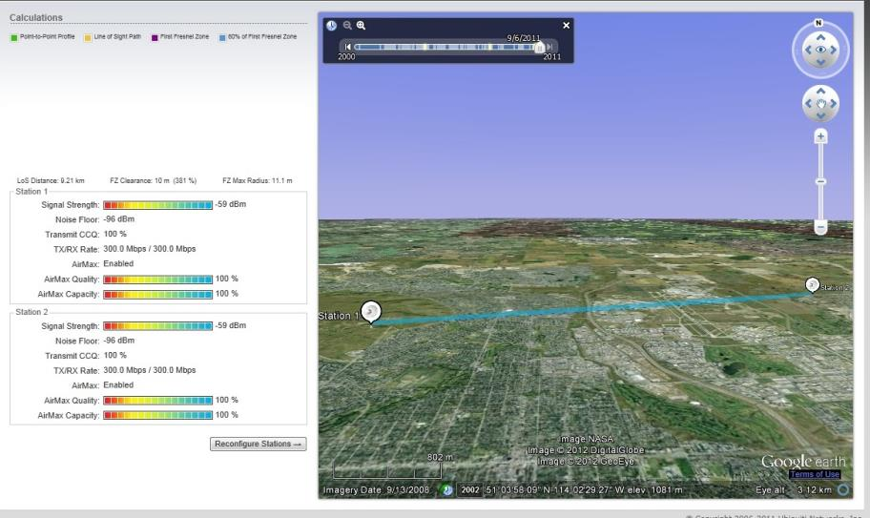
VE6RYC to VE6AO Prediction
Notes:
9.2Km link.

Slide 5
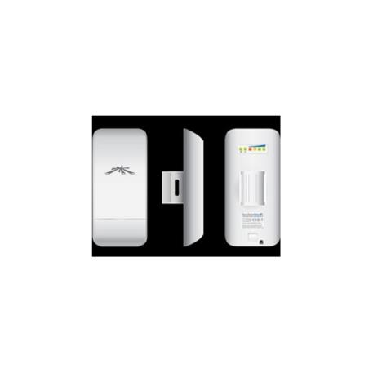
Hardware
Nanostation M5 Loco.
Cost: $70 per side.
Range: Real Range 5 – 10 Km (UBNT says <15km)
Speed: 150Mbit link with 100Mb real measured speed
Size: 163x80mm
Antenna Gain: 13dbi
Output Power: 23dbm
Weight: 0.18Kg
Power consumption: 5.5W max.

Slide 6
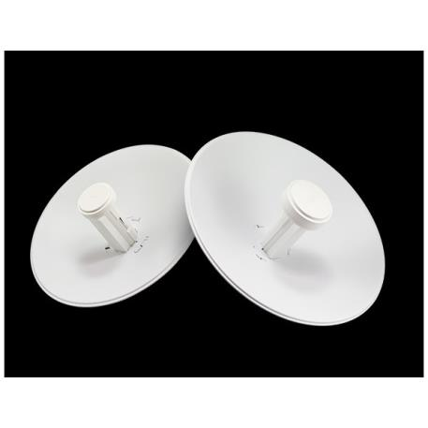
Hardware
NanoBeam m5 400. (This is the one I have here)
Cost: $100 per side.
Range: Real Range 40Km +
Speed: 300Mbit link with >150Mbit real measured speed
Size: 400mm
Antenna Gain: 25dbi
Output Power: 26dbm
Weight: 1.7Kg
Power consumption: 8W max.
Wind Loading: 77lbf @ 125Mph (much less if a Radome is fitted)

Slide 7
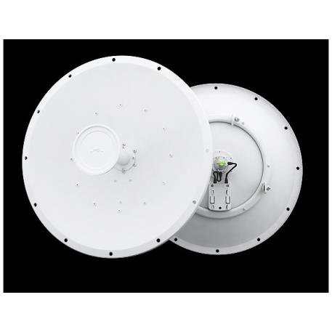
Hardware
Rocket Dish 5G 30. (+Rocket M5 radio)
Cost: $400 per side.
Range: Real Range 160Km +
Speed: 300Mbit link with 100Mbit real measured speed
Size: 648mm
Antenna Gain: 30dbi
Output Power: 27dbm
Weight: 10.3Kg
Power consumption: 6.5W max.
Wind Loading: 113lbf @ 120Mph (much less if a Radome is fitted)

Slide 8
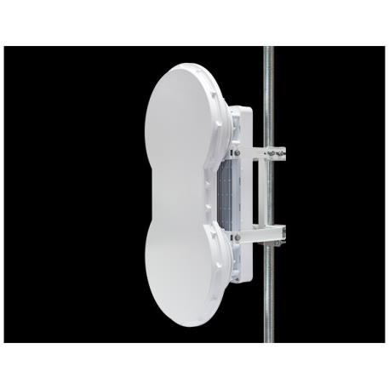
Hardware
AirFiber 5U
Cost: $1,000 per side.
Range: Good for 100Km
Speed: 1Gbit link with 750MBit actual speed
Size: 938x486mm Dual Dish
Antenna Gain: 23dbi
Output Power: ??dbm
Weight: 16Kg
Power consumption: 40W max.
Wind Loading: 194lbf @ 125Mph

Slide 9
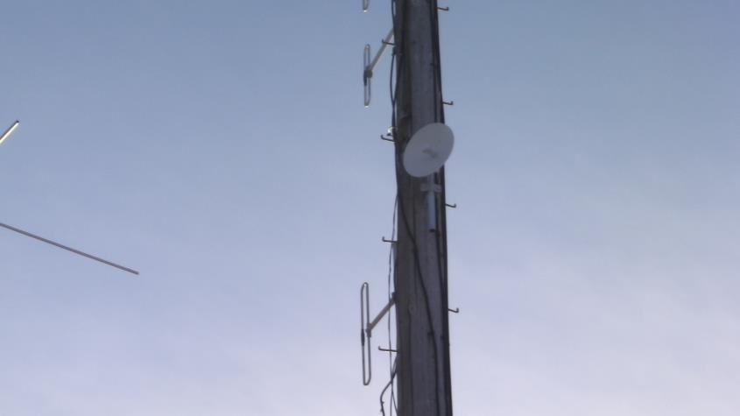
VE6RYC – Nose Hill

Slide 10
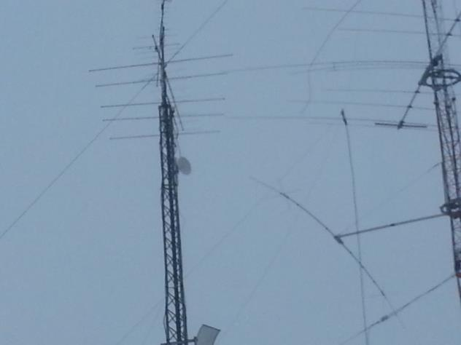
VE6AO – Club Station

Slide 11
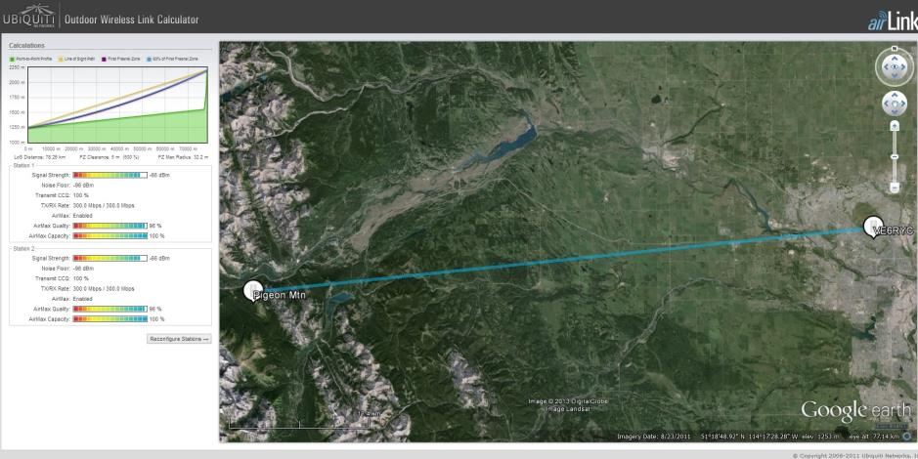
VE6RYC – Pigeon Mtn – 78.26Km

Slide 12
So what can we use the link for?

Slide 13
Remote Config of Repeater control and Radio’s
VOIP Linking between controllers....
(remote may not need a controller)
using Remote Rig (Audio and control signals) needs <100KBit
and Mfi for serial control (and other control)
Repeaters aren’t daisy chained.
Any Combination can be linked by controller
@ VE6RYC over IP/VOIP

Slide 14
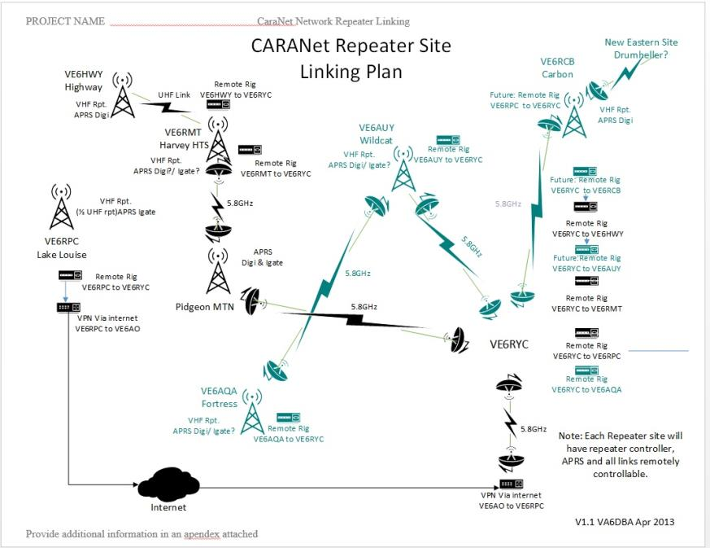

Slide 15
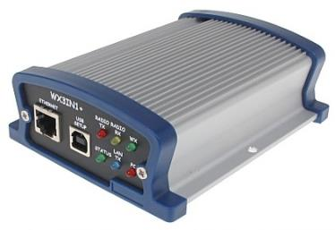
APRS Digipeater and IGate
Can be remotely monitored and configured
Gives Telemetry: Temperature
2x Voltages. Solar in and Battery..
2x Currents charge current etc.
Weather Station.
Notes:
As linked via IP gives redundancy to network.

Slide 16
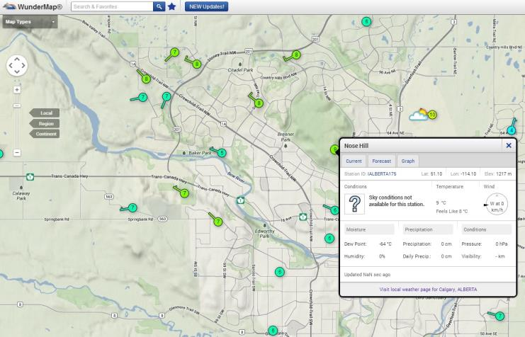
Weather Underground

Slide 17
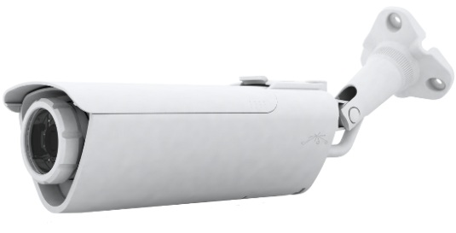
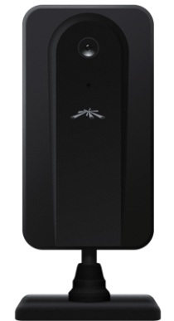
Remote Automated Security
With Automatic recording &
notification of movement

Slide 18
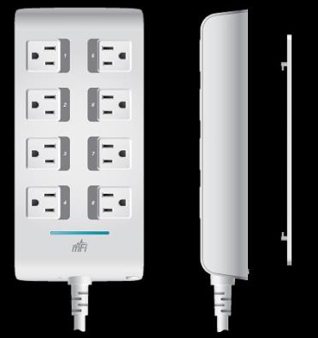
Power Monitoring and Control
12v Power poles
On/Off , and Over/Under Current alarms
110v On/Off Over/Under Current alarms

Slide 19
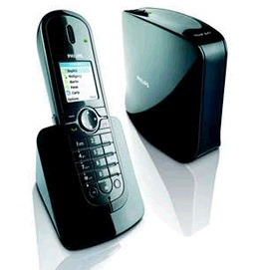
VOIP phone / Phone patch

Slide 20
FreeStar* dual Analog and DStar repeater

Slide 21
IRLP
Using Raspberry Pi solution complete <$300 per node

